Slide 1
Chapter 5 : The Climate of Ethiopia and the Horn of Africa
Outline of the Presentation
Introduction
Definitions of Weather and climate
Elements and Controls of Weather and Climate
Spatiotemporal Patterns and Distribution of Temperature and Rainfall in Ethiopia
Climate Change/Global Warming:
Current Trends of Climate in Ethiopia
Causes of Climate Change
Consequences of Climate Change
Climate Response Mechanisms

Slide 2
Objectives
Upon the completion of this chapter, you will be able to:
Distinguish between weather and climate,
Explicate the spatiotemporal patterns and distribution of temperature and rainfall in Ethiopia,
Analyse climate and its implications on biophysical and socioeconomic aspects,
Comprehend the causes, consequences and response mechanisms of climate change.

Slide 3
Introduction
Ethiopia as a large country in the Horn of Africa, is characterized by:
a wide variety of altitudinal ranges and
diverse climatic conditions.
In addition, the country is subjected to large temporal and spatial variations in elements of weather and climate because of:
its closeness to the equator and
the Indian Ocean
The climate of Ethiopia is, therefore, mainly controlled by:
the seasonal migration of the Intertropical Convergence Zone (ITCZ)
associated atmospheric circulations
complex topography.

Slide 4
Weather is the instantaneous or current state of the atmosphere composing temperature, atmospheric pressure, humidity, wind speed and direction, cloudiness and precipitation.
Climate refers the state of the atmosphere over long periods, decades and more.
Climate change is the change with respect to its characteristics which could be manifested by changes in the average and/or inconsistencies of its major properties that can continue over the long period of time (IPCC, 2007b).
The standard period for climate change is 30 years (WMO, 2009).
It is one of the major global threats to sustainable development because of its impacts on health, infrastructure, settlements, agriculture and food security, and forest ecosystems.
It is mainly manifested in the form of increasing frequency of extreme events such as increased temperatures, drought conditions, floods, land degradation, desertification and biodiversity loss. It is affecting all nations and regions of the world differently depending on their contexts.

Slide 5
Elements and Controls of Weather & Climate
All weather conditions may be traced to the effect of the Sun on the Earth.
Most changes in weather involve large scale horizontal motion of air which is called wind.
The major elements of weather and climate are:
Temperature
Precipitation and humidity
Winds and air pressure
The major controls of weather and climate are:
Latitude/angle of the Sun
Land and water distribution
Winds and air pressure
Altitude and mountain barriers
Ocean currents

Slide 6
Controls of Weather and Climate
The climate of any particular location on earth is determined by a combination of many interacting factors.
These include latitude, elevation, nearby water, ocean currents, topography, vegetation, and prevailing winds.
Moreover, the global climate system and any changes that occur within it also influence local climate.
Hotness or coldness, rainy or cloudiness, sunniness, windiness or calmness, of air you are feeling on the daily base in your current location are expressions of weather.
Now the question one should inquire here is what determines the variations in weather and climate between places and seasons.
Hence, these determining factors are called controls of weather and climate or climatic controls.

Slide 7
Latitude
Latitude is the distance of a location from the equator measured in degrees.
The sun shines directly on equator for more hours during the year than anywhere else.
As you move further away from the equator towards the poles, less solar insolation is received during the year and the temperature become colder.
Ethiopia’s latitudinal location has bearings on its temperature.
Latitudinal location of Ethiopia and the Horn resulted in:
High average temperatures
High daily and small annual ranges of temperature
No significant variation in length of day and night between summer and winter.

Slide 8
Equinoxes and Solstices
An equinox is the instant of time when the sun strikes the plane of the Earth's equator.
During this passage the length of day and night are equal.
Moreover, revolution of the earth along its orbit, the inclination of its axis from the plane of that orbit, and the constant position (parallelism) of the axis causes seasonal changes in the daylight and darkness periods.
Equinox appears twice a year. There are two types of equinoxes:
The Vernal (spring) equinox
It is the day when the point of verticality of sun’s rays crosses the equator northwards.
It experiences in Northern Hemisphere when the sun is exactly above the equator.
During this period, the length of day and night are equal.
It marks the beginning of spring season.
March 21 marks the offset of the this equinox.

Slide 9
The Autumn equinox
It appears when the sun crosses equator giving approximately equal length between day and night.
It appears to happen when the visible sun moves south across the celestial equator on 23rd of September.
It marks the beginning of Autumn season.
Solstice
It is an event when the overhead sun appears to cross northern or southern points relative to the celestial equator resulting in unequal length of days and nights in the hemispheres.
The Summer Solstice
On June 21st, the northern hemisphere has maximum tilt towards the sun experiencing longest daylight of the year.
It is the astronomical first day of summer in the Northern Hemisphere.
The sun is at its highest position in the noonday sky, directly above 23½° in the Tropic of Cancer.

Slide 10
The Winter Solstice
On 22nd of December, the day when the maximum southward inclination is attained in the Southern Hemisphere.
In this event the sun travels shortest length causing longest night and shortest daylight.
In the Northern Hemisphere, it occurs when the sun is directly over the Tropic of Capricorn, which is located at 23½° south of the equator.
Altitude
Do you have any experience of visiting high elevation places?
What differences have you felt between the lowest and highest elevations?
Altitude is the height of location above the sea level.
Under normal conditions there is a general decrease in temperature with increasing elevation.
The average rate at which temperature changes per unit of altitudinal change is known as lapse rate.
The lapse rate is limited to the lower layer of the atmosphere named as troposphere.

Slide 11
The normal lapse rate is 6.5°C per kilometer rise in altitude.
There are 3 types of lapse rates
i. Dry adiabatic laps rate
An adiabatic lapse rate is the rate at which the temperature of an air parcel changes in response to the expansion or compression process associated with a change in altitude.
When air rises, it expands because there is less weight of air upon it.
Thus, if a mass of dry air at sea level rises to an altitude of about 5486.22meters, the pressure upon it is reduced by nearly half and consequently its volume is doubled.
If the upward movement of air does not produce condensation, then the energy expanded by expansion will cause the temperature of the mass to fall at the constant dry adiabatic lapse rate.

Slide 12
The rate of heating or cooling is about 10°C for every 1000m of change in elevation.
This rate applies only to unsaturated air, and thus it is called the dry adiabatic laps rate
ii. Wet Adiabatic laps rate
The rate at which rising or sinking saturated air changes its temperature is less than the dry adiabatic rate.
Prolonged cooling of air invariably produces condensation, thereby liberating latent heat.
Therefore, rising and saturated or precipitating air cools at a slower rate than air that is unsaturated.
This process is called wet adiabatic temperature change.
The rate of cooling of wet air is approximately 5°C per 1000meters ascend.

Slide 13
iii. Environmental lapse rate/Atmospheric lapse late
This refers to the actual, observed change of temperature with altitude.
The fact that air temperature is normally highest at low elevations next to the earth and decreases with altitude.
This decrease in temperature upward from the earth's surface normally prevails throughout the lower atmosphere called troposphere.
The principal exception to the rule is the cause of temperature inversions.
The rate of change is 6.5°C/1000meters

Slide 14
Spatiotemporal Distribution of Temperature
The spatial distribution of temperature in Ethiopia is primarily determined by altitude and latitude.
The location of Ethiopia at close proximity to equator, a zone of maximum insolation, resulted for every part of the country to experience overhead sun twice a year.
However, in Ethiopia, as it is a highland country, tropical temperature conditions have no full spatial coverage.
They are limited to the lowlands in the peripheries.
Away from the peripheries the land begins to rise gradually and considerably, culminating in peaks in various parts of the country.
Thus temperature, as it is affected by altitude, decreases towards the interior highlands.
Mean annual temperature varies from over 30°C in the tropical lowlands to less than 10°C at very high altitudes.
The Bale Mountains are among highlands where lowest mean annual temperatures are recorded.

Slide 15
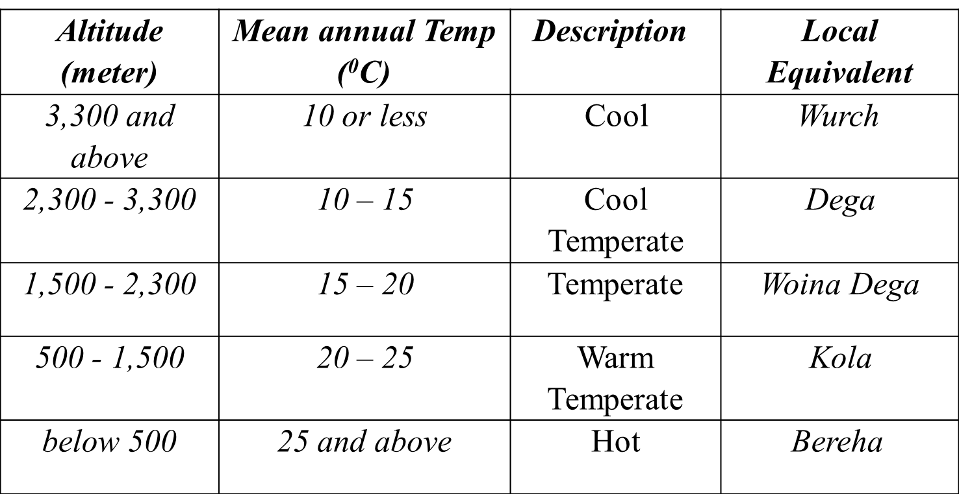
The highest mean maximum temperature in the country is recorded in the Afar Depression.
Moreover, lowlands of north-western, western and south-eastern Ethiopian experiences mean maximum temperatures of more than 30 °C .
Environmental influences have their own traditional expressions in Ethiopia and there are local terms denoting temperature zones as shown below

Slide 16
The temporal distribution of Ethiopian temperature is characterized by extremes.
The major controls determining its distributions are latitude and cloud cover.
However, some parts of the country enjoy a temperate climate.
In the tropics, the daily range of temperature is higher and the annual range is small, whereas the reverse is true in the temperate latitudes.
In Ethiopia, as in all places in the tropics, the air is frost free and changes in solar angles are small making intense solar radiation.
Ethiopia’s daily temperatures are more extreme than its annual averages.
Daily maximum temperature varies from a high of more than 37°C over the lowlands in northeast and southeast to a low of about 10-15°C over the northwestern and southwestern highlands.
The variation in the amount of solar radiation received daily is small throughout the year.

Slide 17
In Ethiopia and elsewhere in the Horn of Africa, temperature shows seasonal variations.
For example, months from March to June in Ethiopia have records of highest temperatures. Conversely, low temperatures are recorded from November to February.
It is not easy to observe distinct variation in temperature between seasons as the sun is always high in the tropics.
However, there is a slight temperature increase in summer
Southern part of Ethiopia receives highest records of temperature in autumn and spring following the relative shift of the sun; whereas in the northern part of the country, summer season is characterized by higher temperature.
It has to be noted that certain seasons should have special considerations.
For instance, unlike other parts of Ethiopia, the southern and southwestern highlands experience reduced temperature.
This is because the temperature and the amount of energy reaching the surface is directly related with the directness of the sun.

Slide 18
Spatiotemporal Distribution of Rainfall
Rainfall in Ethiopia is influenced by the position of Intertropical Convergence Zone (ITCZ).
The convergence of Northeast Trade winds and the Equatorial westerlies forms the ITCZ, which is a low-pressure zone.
The inter-annual oscillation of the surface position of the ITCZ causes a variation in the Wind flow patterns over Ethiopia and the Horn.
Following the position of the overhead sun, the ITCZ shifts north and south of the equator.
As the shift takes place, equatorial westerlies from the south and southwest invade most parts of Ethiopia bringing moist winds.
The ITCZ shifts towards south of the equator (Tropic of Capricorn) in January.
During this period, the Northeast Trade Winds carrying non-moisture-laden dominates the region.
Afar and parts of Eritrean coastal areas experience rainfall in this period.
Following the directness of the sun in March and September around the equator, the ITCZ shifts towards equator.
During this time, the central highlands, southeastern highlands and lowlands receives rainfall as the south easterlies bring moist winds.

Slide 19
Seasonal or Temporal Variability of Rainfall in Ethiopia
The seasonal and annual rainfall variations observed in Ethiopia are the results of the macro-scale pressure systems and monsoon flows which are related to the changes in the pressure system.
1. Summer season (June, July, August)
From mid-June to mid-September, majority of Ethiopian regions, except lowlands in Afar and Southeast, receive rainfall during the summer season as the sun overheads north of the equator
High pressure cells develop on the Atlantic and Indian Oceans around the tropic of Capricorn although the Atlantic contributes a lot; the Indian Ocean is also source of rainfall.
During this season, Ethiopia and the Horn of Africa come under the influence of the Equatorial westerlies (Guinea monsoon) and Easterlies.
Hence, the Guinea monsoon and the South easterly winds are responsible for the rain in this season.

Slide 20
2. Autumn Season (September, October and November)
In autumn the ITCZ shifts towards the equator weakening the equatorial westerlies.
During this season, the south easterlies from Indian Ocean showers the lowlands in southeastern part of Ethiopia
3. Winter season (December, January and February)
The overhead sun is far south of equator.
Northeasterly winds originating from the landmass of Asia dominantly prevail Ethiopian landmass.
However, it has no significant coverage compared to other seasons.
The northeasterly winds crossing the Red Sea carry very little moisture and supplies rain only to the Afar lowlands and the Red Sea coastal areas.
4. Spring Season (March, April and May)
The noonday sun is shining directly on the equator while shifting north from south.
The shift of the ITCZ, results in longer days and more direct solar radiation providing warmer weather for the northern world.
In this season, the effect of the northeast trade wind is very much reduced.
Conversely, the Southeasterlies from the Indian Ocean provide rain to the highlands of Somalia, and to the central and southeastern lowlands and highlands of Ethiopia

Slide 21
Rainfall Regions of Ethiopia
Based on rainfall distribution, both in space and time, four rainfall regions can be identified in Ethiopia and the Horn. These are:
i. Summer rainfall region
This region comprises almost all parts of the country, except the southeastern and northeastern lowlands.
The region experiences most of its rain during summer (kiremt), while some places also receive spring (Belg) rain.
The region is divided into dry and wet summer rainfall regions.
Hence, the wet corresponds to the area having rainfall of 1,000mm or more.
The High altitudes and the windward side experience such rainfall amount.
ii. All year-round rainfall region
It has many rainy days than any part of the country.
It is a rainfall region in the southwestern part of the country.

Slide 22
The wetness of this region is particularly due to the prepotency of moist air currents of equatorial westerlies called the Guinea Monsoons.
Both duration and amount of rainfall decreases as we move from southwest to north and eastwards.
The average rainfall in the region varies from 1,400 to over 2,200mm/year.
iii. Autumn and Spring rainfall regions
The region comprises areas receiving rain following the influence of southeasterly winds.
South eastern lowlands of Ethiopia receive rain during autumn and spring seasons when both the north easterlies and equatorial westerlies are weak.
About 60% of the rain is in autumn and 40% in spring.
The average rainfall varies from less than 500 to 1,000mm.
iv. Winter rainfall region
This rainfall region receives rain from the northeasterly winds.
During the winter season, the Red sea escarpments and some parts of the Afar region receive their main rain.

Slide 23
Agro-ecological Zones of Ethiopia
As a result of the diversified altitude and climatic conditions, Ethiopia possesses diverse agroclimatic zones
These zones have traditionally been defined in terms of temperature.
This system divides the nation into five major climatic zones namely Bereha, Kolla, Woina Dega, Dega and Wurch.
A description on each of the zones is presented as follows.
The Wurch Zone
The Wurch-zone is an area having altitude higher than 3,200meters above sea level and mean annual temperature of less than 10°C.
Mountains having typically fitting characteristics of this zone include mountain systems of Ras Dashen, Guna, Megezez in North Shoa, Batu, Choke, Abune Yoseph etc.

Slide 24
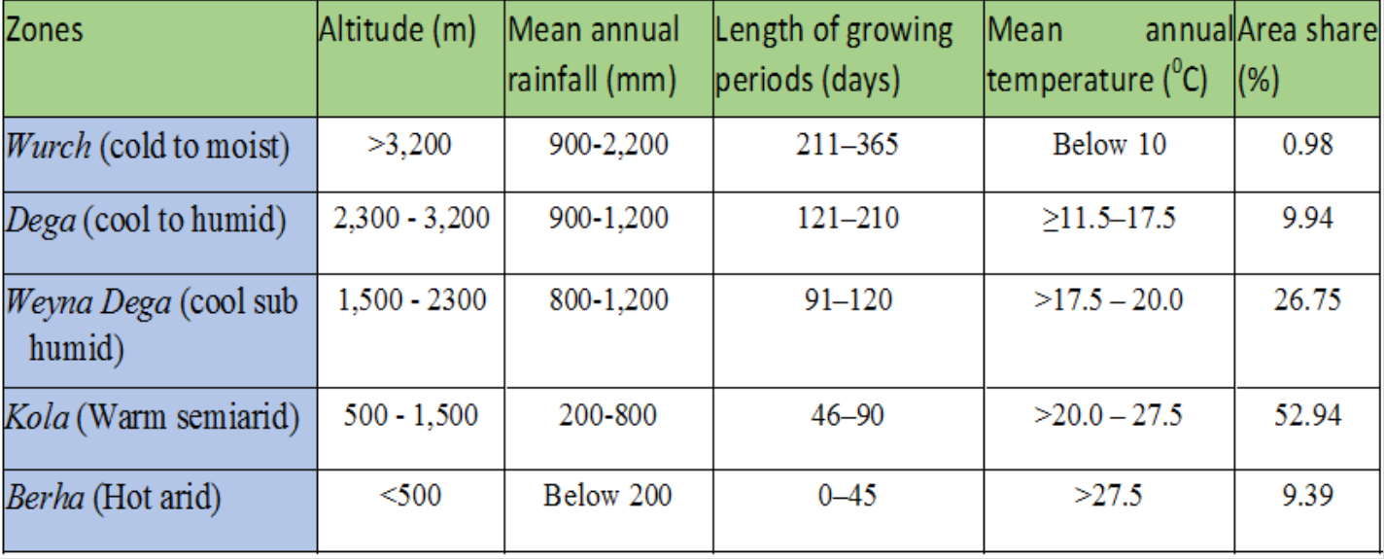
Dega Zone
This is a zone of highlands having relatively higher temperature and lower altitude compared to the wurch Zones.
In Ethiopia, the Dega-zone is long inhabited and has dense human settlement due to reliable rainfall for agriculture and absence of vector-borne diseases such as malaria.
This table shows Agro Ecological Zones of Ethiopia

Slide 25
Weyna Dega Zone
This zone has warmer temperature and moderate rainfall.
It lies between 1500-2,300meters above sea level.
It is the second largest zone covering more than 26% of the landmass of Ethiopia.
The temperature and rainfall of this category is highly suitable for majority of crops grown in Ethiopia.
Hence, the zone includes most of the agricultural land.
The Weyna Dega zone has also two growing seasons.
Kolla Zone
In Ethiopia, the geographic peripheries in south, southeast, west and northeastern part are mainly in this category.
It is the climate of the hot lowlands with an altitudinal range of 500 to 1500meters above sea level.
Average annual temperature ranges between 20°C and 30°C.
Although mean annual rainfall is erratic, it can be as high as 1500mm in the wet western lowlands of Gambella.

Slide 26
Bereha Zone
It is the hot arid climate of the desert lowlands.
It is largely confined to lowland areas with altitude of lower than 500meters.
Around Danakil depression, the elevation goes below the sea level.
Its average annual rainfall is less than 200mm, and average annual temperature is over 27.5°C.
Djibouti, majority of Somalia, and coastal areas of Eritrea are categorized under Kolla and Bereha zones.

Slide 27
Climate Change: Causes, Consequences and Response Mechanisms
Climate change refers to a change in the state of the climate that can be identified by changes in the mean and/or the variability of its properties and that persists for an extended period, typically decades or longer.
Current Trends of Climate in Ethiopia
Besides spatial and temporal variations in different parts of the country, Ethiopian climate experiences extremes such as drought, flood etc.
In the country, 12 extreme drought events were recorded between 1900 and 2010.
Among the 12, seven of the drought events occurred since 1980.
The majority of these resulted in famines.
The severe drought of 2015-2016 was exacerbated by the strongest El Nino that caused successive harvest failures and widespread livestock deaths in some regions.

Slide 28
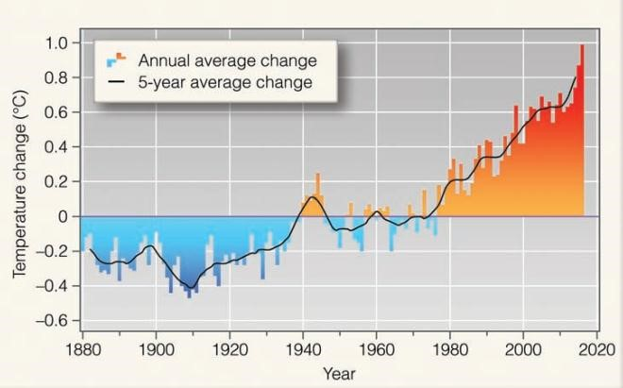
Global mean temperature anomaly.

Slide 29
Trends in Temperature Variability
In Ethiopia the mean annual temperature has shown 0.2°C to 0.28°C rise per decade over the last 40-50 years.
A rise in average temperature of about 1.3°C has been observed between 1960 and 2006.
Higher rise in temperature was noted in drier areas in northeast and southeast part of the country.
Notably the variability is higher in July-September.
Consequently, the country’s minimum temperature has increased with 0.37°C to 0.4°C per decade.
Trends in Rainfall Variability
Precipitation has remained fairly stable over the last 50 years when averaged over the country.
Rainfall variability is increasing (and predictability is decreasing) in many parts of the country.
In some regions, total average rainfall is showing decline.
For instance, parts of southern, southwestern and south-eastern regions receiving Spring and Summer rainfall have shown decline by 15-20% between 1975 and 2010.

Slide 30
Causes of Climate Change
A. Natural Causes
Earth orbital changes
Changes in the tilt of the earth at an angle of 23.5° can lead to small but climatically important changes in the strength of the seasons.
More tilt means warmer summers and colder winters.
Energy Budget
Although the Sun’s energy output appears constant, small changes over an extended period of time can lead to climate changes.
Since the Sun was born, 4.5 billion years ago, the star has been very gradually increasing its amount of radiation so that it is now 20% to 30% more intense than it was once.

Slide 31
Volcanic Eruptions
It releases large volumes of sulphur dioxide, carbon dioxide, water vapor, dust, and ash into the atmosphere.
The release of large volume of gases and ash can increase planetary reflectivity causing atmospheric cooling.
B. Anthropogenic Causes
The warming of earth planet in the past 50 years is majorly driven by human activities.
The industrial activities that our modern civilization depends upon have raised atmospheric carbon dioxide levels from 280 parts per million to 400 parts per million in the last 150 years.
Human induced greenhouse gases such as carbon dioxide, methane and nitrous oxide have caused much of the observed increase in Earth's temperatures over the past 50 years.
The major gases that contribute to the greenhouse effect include Water vapor, Carbon dioxide (CO2), Methane, Nitrous oxide, Chlorofluorocarbons (CFCs).
Although methane is less abundant in atmosphere, it is by far more active greenhouse gas than carbon dioxide.

Slide 32
Consequences of Climate Change
In many parts of the world, climate change has already
loss of life,
damaging property and
affecting livelihoods.
The impact of climate change is higher in low income countries, since they have limited capacity to cope with the changes.
Some of the consequences of the climate change include:
Impacts on human health,
Impact on water resources,
Impact on Agriculture, and impact on Ecosystem

Slide 33
Climate Change Response Mechanisms
There are three major response mechanisms to climate change namely
mitigation,
adaptation and
resilience.
Climate Change Mitigation Strategies
Mitigation measures are those actions that are taken to reduce and control greenhouse gas emissions changing the climate.
Moreover, it implies reducing the flow of heat trapping greenhouse gases into the atmosphere, either by reducing sources of these gases or enhancing the “sinks” that accumulate and store these gases (such as the oceans, forests and soil).
There are some climate change mitigation measures that can be taken to avoid the increase of pollutant emissions. Practice Energy efficiency,
Increase the use of renewable energy such as solar
Efficient means of transport implementation: electric public transport, bicycle, shared cars etc.

Slide 34
Climate change adaptation strategies
Adaptation is simply defined as adapting to life in a changing climate.
It involves adjusting to actual or expected future climate.
The goal is to reduce our vulnerability to the harmful effects of climate change such as extreme weather events or food insecurity.
It also encompasses making the most of any potential beneficial opportunities associated with climate change
Some of the major climate change adaptation strategies are:
Building flood defenses,
Plan for heat waves and higher temperatures,
Installing water-permeable pavements to better deal with floods and storm water,
Improve water storage,
Landscape restoration and reforestation,
Flexible and diverse cultivation to be prepared for natural catastrophes,
Preventive and precautionary measures such as evacuation plans, health issues, etc.

Slide 35

